Slide 1
DPG Collaboration
Steve Haley, Mojaloop Foundation
Michael Richards, ModusBox

Slide 2
What are DPGs and DPIs?
DPG – Digital Public Goods
open-source software, open data, open AI models, open standards and open content that adhere to privacy and other applicable laws and best practices, do no harm by design, and help attain the SDGs (Digital Public Goods Alliance)
DPI – Digital Public Infrastructure
horizontal enablers across all sectors that connect government, individuals and markets

Slide 3





Examples

Slide 4
Benefits of Collaboration
Joint advocacy
around DPI
around open source
donors
Educating governments and ecosystems about:
“How” to implement and maintain DPI projects
Lessons learned
Reference architecture for digital societies

Slide 5
Benefits of Collaboration (cont’d)
Sharing technical resources
Ensuring interoperability across systems
Security best practices
Avoid duplication and (inefficient) competition

Slide 6
Challenges of Collaboration
Different stages of development
Different OS governance structure and implementation modality
Resource competition
Similar donor pool
Cross ministry collaboration

Slide 7


Modes of Collaboration
Donor level
Business level
Developer level
POCs
Find specific markets

Slide 8
Examples
OpenG2P – MOSIP
Mojaloop – MIFOS
OpenG2P – Mojaloop
Mojaloop – OpenIMIS

Slide 9
Case Study - OpenIMIS
The goal of OpenIMIS: “to improve health financing operations by offering a seamless exchange of data related to patients, health service providers and payers for health care.”
The Payment System interface provides a way for OpenIMIS to:
Pay service providers for the work they do.
Receive subscriptions from members of health care schemes.
Disburse funds such as grants to beneficiaries.

Slide 10
Case Study - OpenIMIS
Uses OpenHIM as a middleware component to mediate between the Health Management System and the Payment System.
The Health Management System appears as a TPP (Third Party Provider) in the Payment System.
Provides specialised openHIM mediators to:
Execute payments to suppliers based on invoices.
Receive payments from subscribers.
Execute bulk payments to beneficiaries.

Slide 11
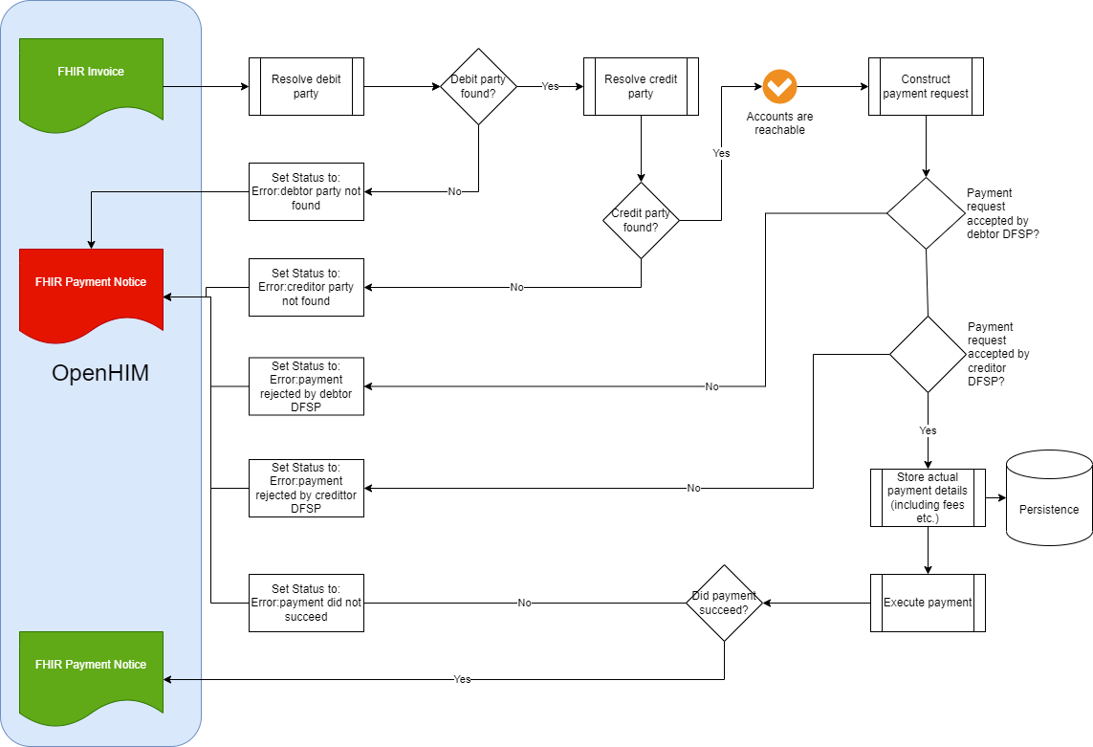

Slide 12
What are some other areas?
#dpg-collab in slack
Steve Haley shaley@mojaloop.io
Ed Cable edcable@mifos.org
Michael Richards michael.richards@modusbox.com

Slide 13
Thank you!

